Slide 1
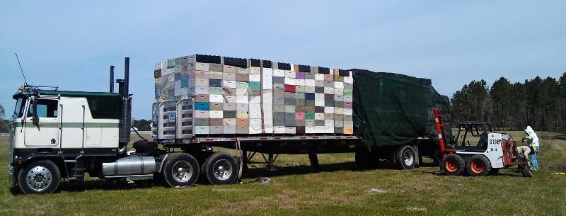
Home sick: Effects of migratory beekeeping on honey bee disease
---
P. Alexander Burnham, Samantha Alger, Leif Richardson & Zachary Lamas
keychainlogistics.com

Slide 2
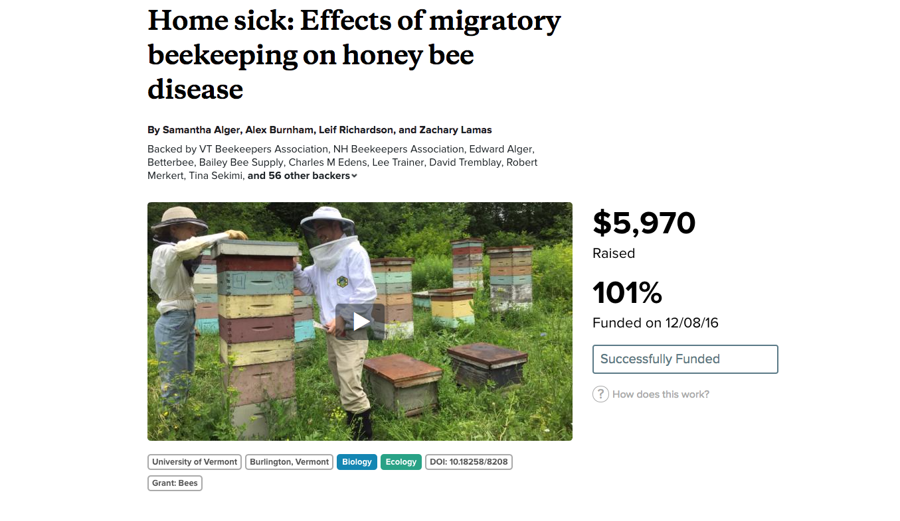
www.experiment.com/beekeeping

Slide 3


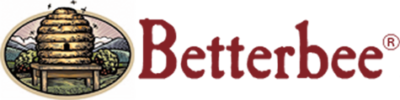


Acknowledgments

Slide 4
And Most of all, our Backers…
VT Beekeepers Association, NH Beekeepers Association, Edward Alger, Betterbee, Bailey Bee Supply, Charles M Edens, Lee Trainer, David Tremblay, Robert Merkert, Tina Sekimi, Mike Kiernan, Sandra Tomlinson, Amy Handy, Joe Perry, Luke Manlove, Dan Boisvert, Jacqueline Alger, Dan O'Hanlon, Patrick Gillen, Alison K Brody,Daniel Hall Lipke, Beth Sawyer, Cathy Wilson, Allison Malloy, Richard Reid, Nicole Berthiaume, Heather Achilles, Phyllis E Burnham, Yeager Anderson, Bill Castro, Luke Tilley,Jonathan Alger, Peter Gatehouse, Amy Parachnowitsch, Trevor Brandt, Katie Iles, JESSICA PAGANO, Kate Protagonist, Andrea Stanley, Robert Zywno, Helmut Besser, Allen Turechek,Adrian Adam Zywno, Kirsten Shoshanna Traynor, Meghan O'Rourke, Jean McCartin, Ben Ritchie, Vicki Anne, Hollis Woodard, James DeRosia, The Backyard Farm, Malcolm Hobbs,Aaron Schwartz, Linda Battista, Lauren Ash, Raphaël Royauté, Kay Newhouse, Maggie Davern, Joanne Bryan, Sarah Rommelfanger, Pureum Kim, Luke McCartin, Kendall Johnson,Sara Held, Eric Damon Walters, and Bo Sprotte Kofod

Slide 5
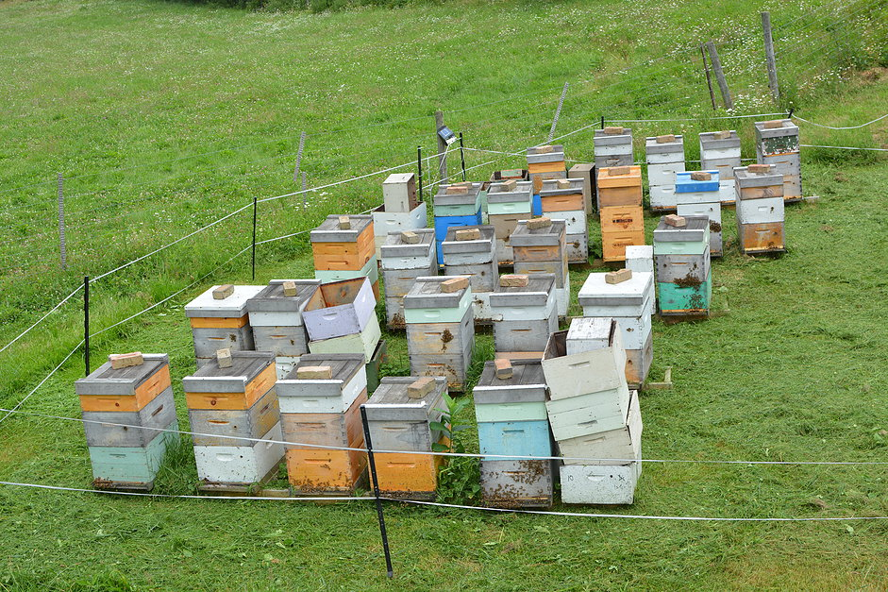
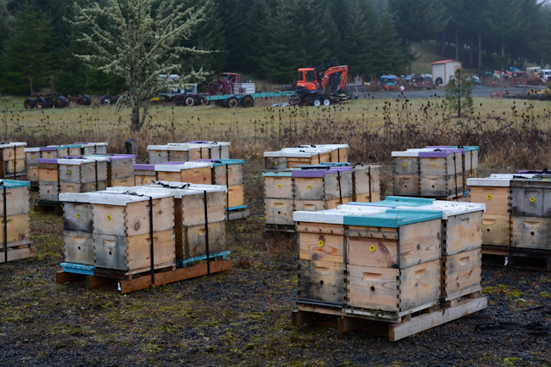
Two Main Types of Bee Operations…
Stationary Apiaries:
Migratory Apiaries:
&
bedillionhoneyfarm.com
waywardspark.com

Slide 6
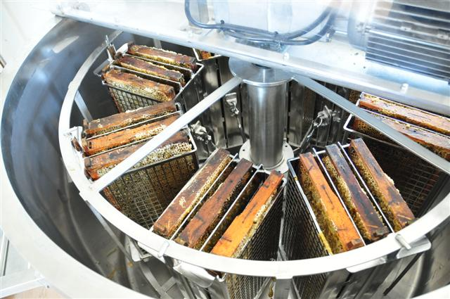
Stationary
Honey Production
Queen Breeding
Selling Nucs
Pollination
coxhoney.com

Slide 7
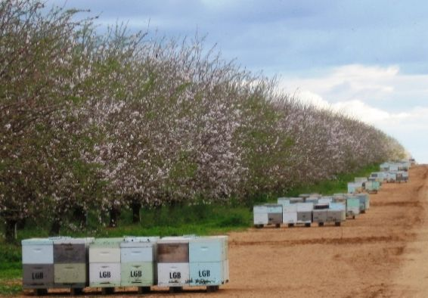
Migratory
Pollination Contracts
Almonds
Canola
Blueberries etc.
~60% of US colonies pollinate almonds
$14.6 Bil. industry
(Cavigli et al., 2016)
Australian Broadcasting Co.
(Morse & Calderone, 2000)

Slide 8
Anecdotally, some people believe that migratory beekeeping leads to unhealthy bees
WHY?

Slide 9


Spread of Disease
Big Cities (migratory):
-high disease transmission
Small Towns (stationary):
-low disease transmission
huffingtonpost.com

Slide 10
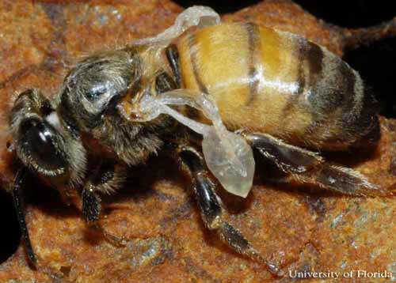
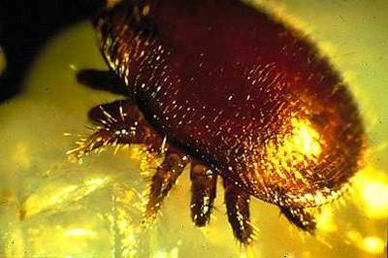
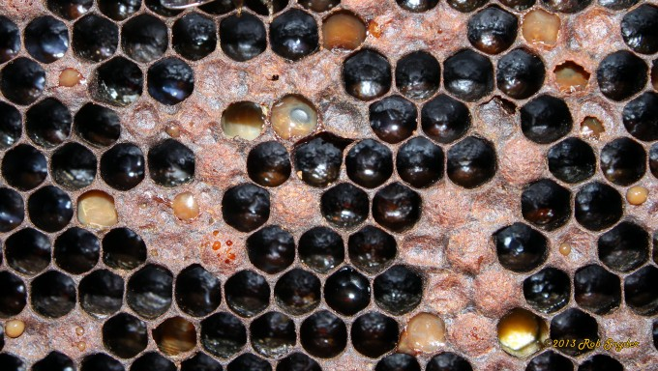
Honey Bee Pathogens:
VIRUSES:
Deformed Wing Virus (DWV)
Black Queen Cell Virus (BQCV)
Israeli Acute Paralysis Virus (IAPV)
PARASITES:
Nosema (ceranae & apis)
Varroa Mite
OTHER PATHOGENS & Pests:
American Foulbrood (AFB)
European Foulbrood (EFB)
Chalk Brood
Black shiny bee
Small Hive Beetle
Deformed wing Virus
University of Florida,
Entomology Dept.
Varroa destructor
North Carolina State University,
Cooperative Extension
American Foulbrood
Bee Informed Partnership

Slide 11
The big question!
“Do migratory operations contribute to the spread of honeybee disease?”

Slide 12
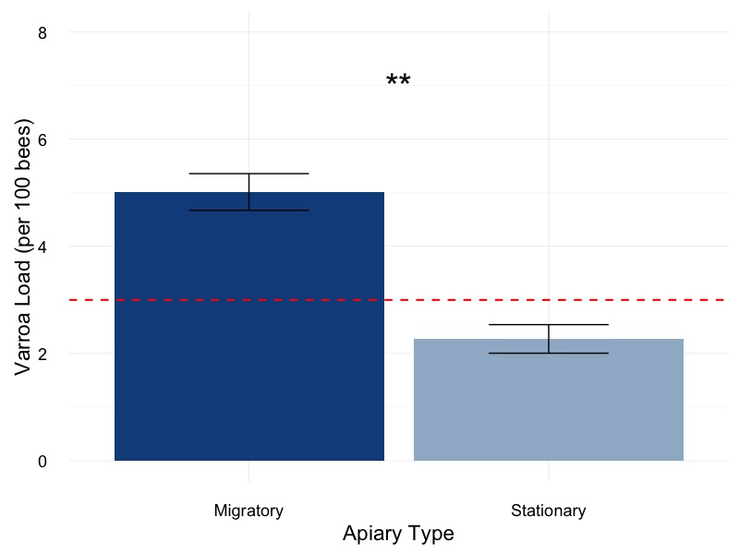
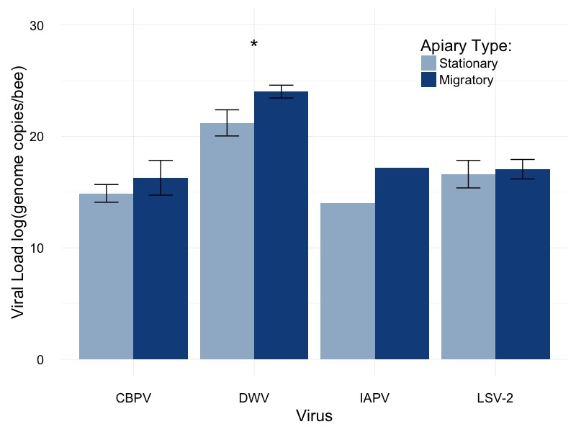
Preliminary Data from the National Honey Bee Survey in Vermont…
Varroa Mites:
RNA Viruses:

Slide 13
What other people have found:
Migratory operations can have high disease loads
Infected hives may transmit disease to other bees
Varroa loads can be lower in migratory bees
These data are correlative:
Surveys
Observational studies
(Welch et al., 2009; Cavigli et al., 2016)
(Fürst et al., 2014)
(NHBS report, 2016)

Slide 14
Our Hypotheses
Two parts to this experiment:
Part I: Do migratory colonies have higher pathogen levels than stationary colonies?
Part II: Can migratory colonies infect stationary colonies upon their return?

Slide 15
Experimental Design
Three groups of colonies:
Migratory
Stationary (control)
Stationary (exposed)
Each group contained 16 colonies
Sampled at three different times

Slide 16
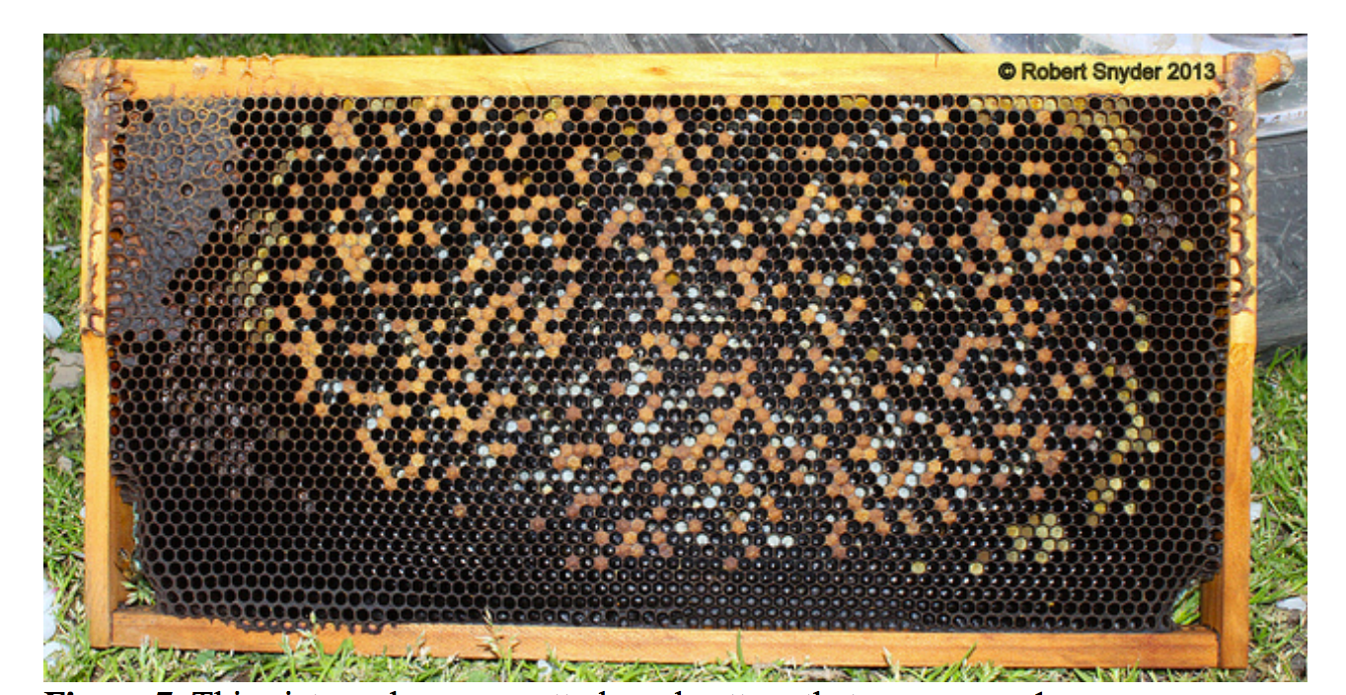
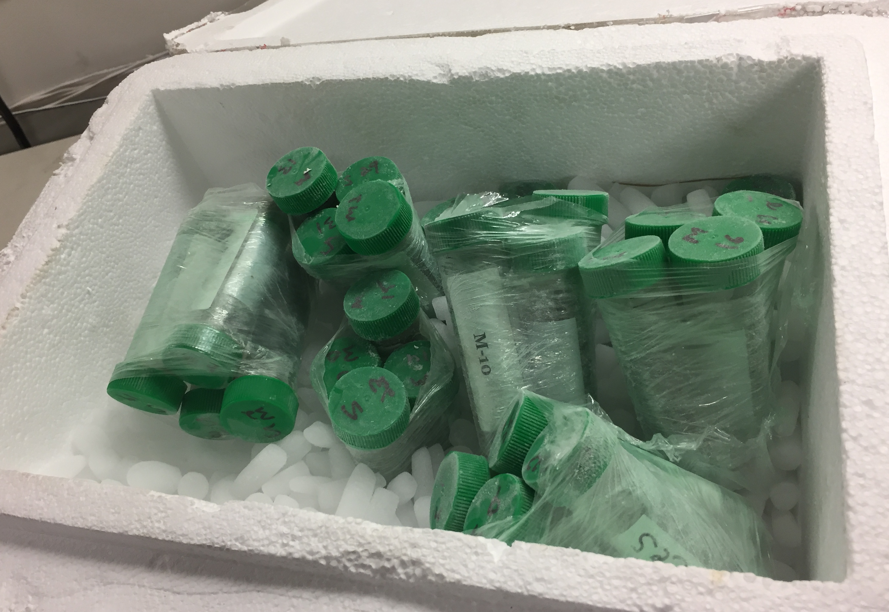
Experimental Design
Field inspection:
Common brood diseases
Frames of brood
Brood pattern
Laboratory Analysis:
Varroa load
Nosema load
Viruses: DWV, BQCV, IAPV

Slide 17



Experimental Design for Migratory/Stationary Honey Bee Experiment Part I
CA
NC
Migratory Group
Migratory Group
Stationary Group
- Do migratory colonies have higher pathogen levels than stationary colonies?

Slide 18
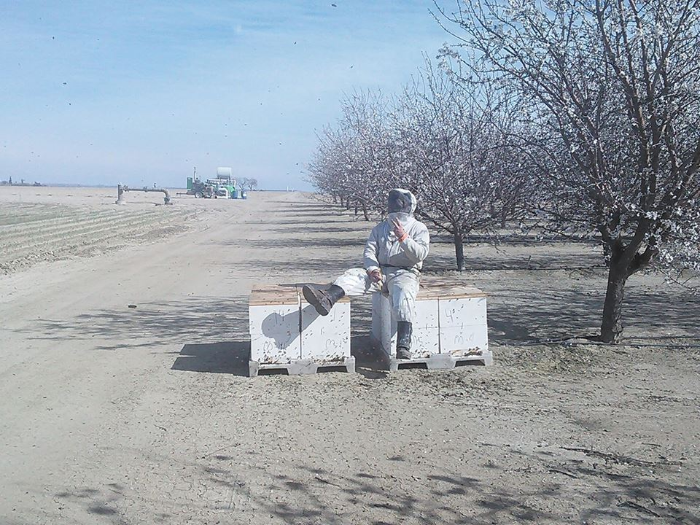

Slide 19
Do migratory colonies have higher pathogen levels than stationary colonies?
Part I: Results

Slide 20
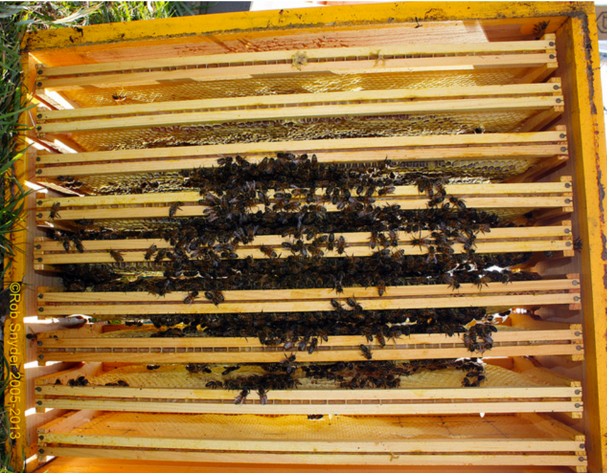
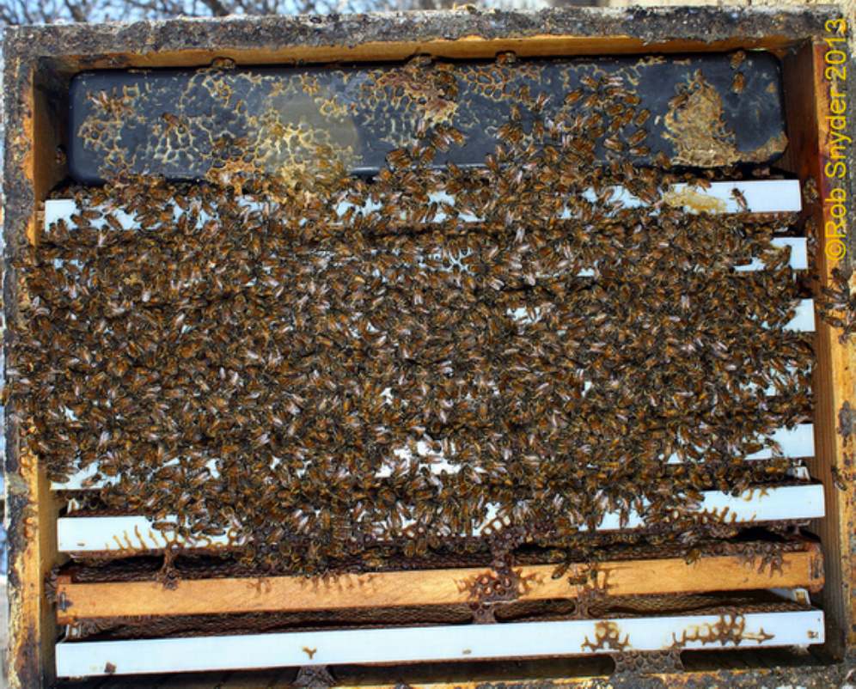
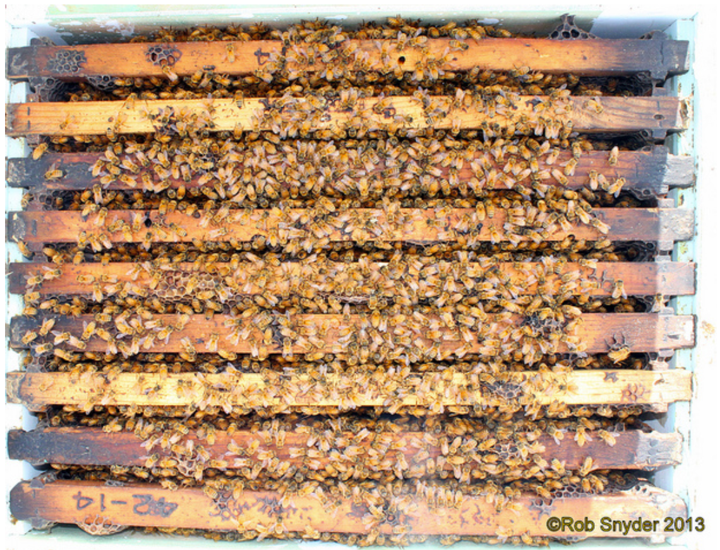
Part I: Results Frames of Bees
BIP Tech Transfer Team Protocol Manual

Slide 21
Part I: Results Frames of Bees

Slide 22
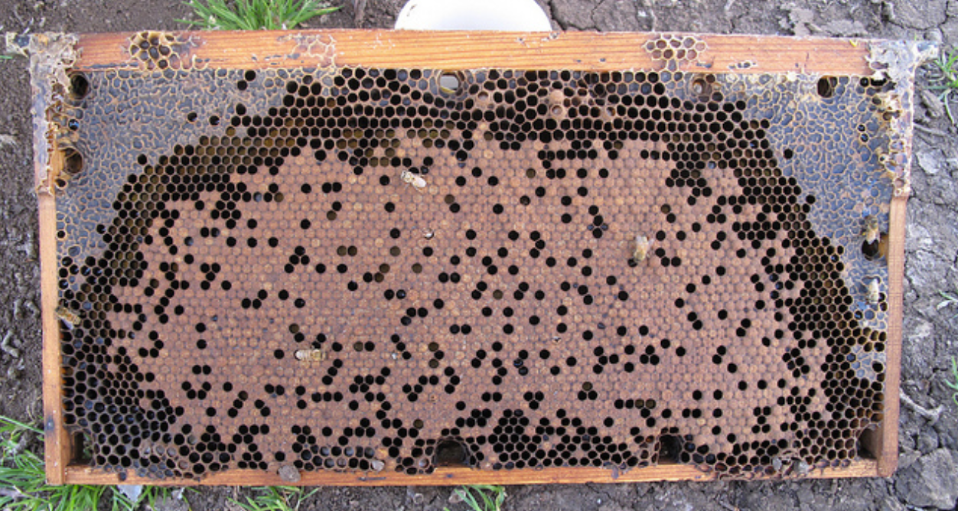
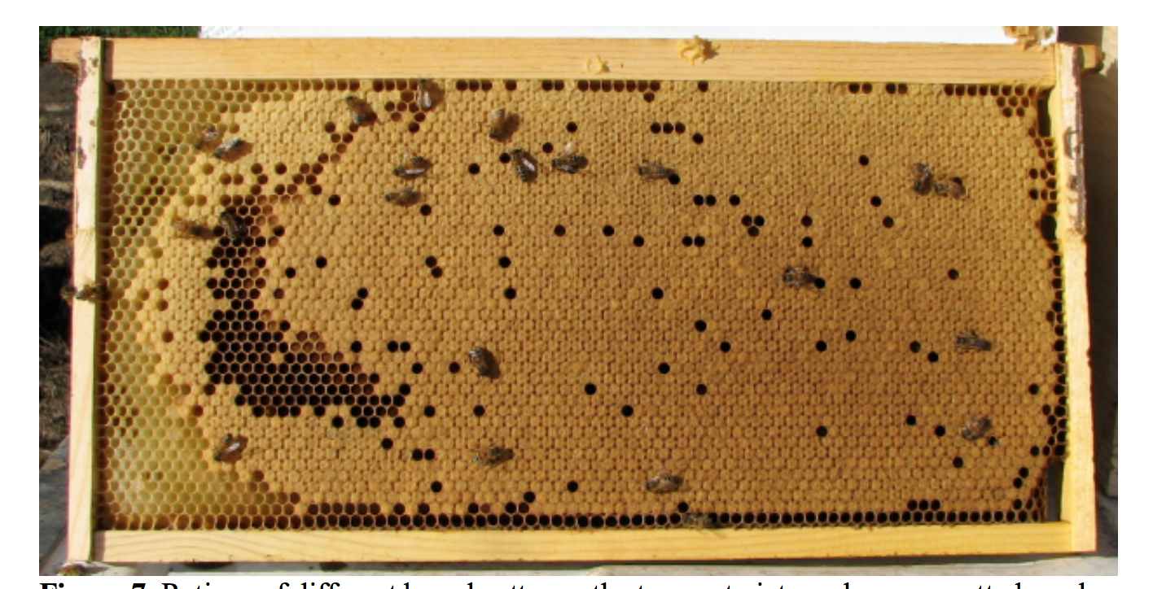
Part I: Results Brood Pattern
BIP Tech Transfer Team Protocol Manual

Slide 23
Part I: Results Brood Pattern

Slide 24
Part I: Results Varroa load

Slide 25
Part I: Results Deformed Wing Virus Prevalence

Slide 26
Part I: Results Deformed Wing Virus Load

Slide 27
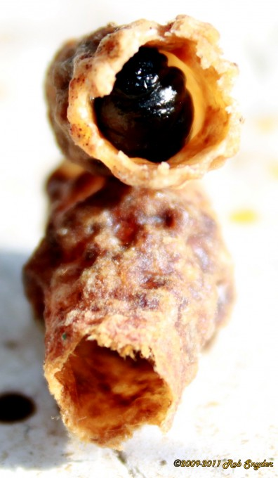
Part I: Results Black Queen Cell Virus Load

Slide 28
Experimental Design for Migratory/Stationary Honey Bee Experiment Part II
CA
NC
Exposed Group
Stationary Group
Migratory Group
- Can migratory colonies infect stationary colonies upon their return?

Slide 29
Part 2: Results Frames of Bees

Slide 30
Part 2: Results Brood Pattern

Slide 31
Part 2: Results Varroa load

Slide 32
Part 2: Results Deformed Wing Virus Prevalence

Slide 33
Part 2: Results Deformed Wing Virus Load

Slide 34
Part 2: Results Black Queen Cell Virus Load

Slide 35
Discussion
The purpose of this study is NOT to assign blame to migratory beekeeping.
Migratory beekeeping is very important for our agriculture and economy.
We hope to learn more about how beekeeping practices play into transmission and bee health.

Slide 36
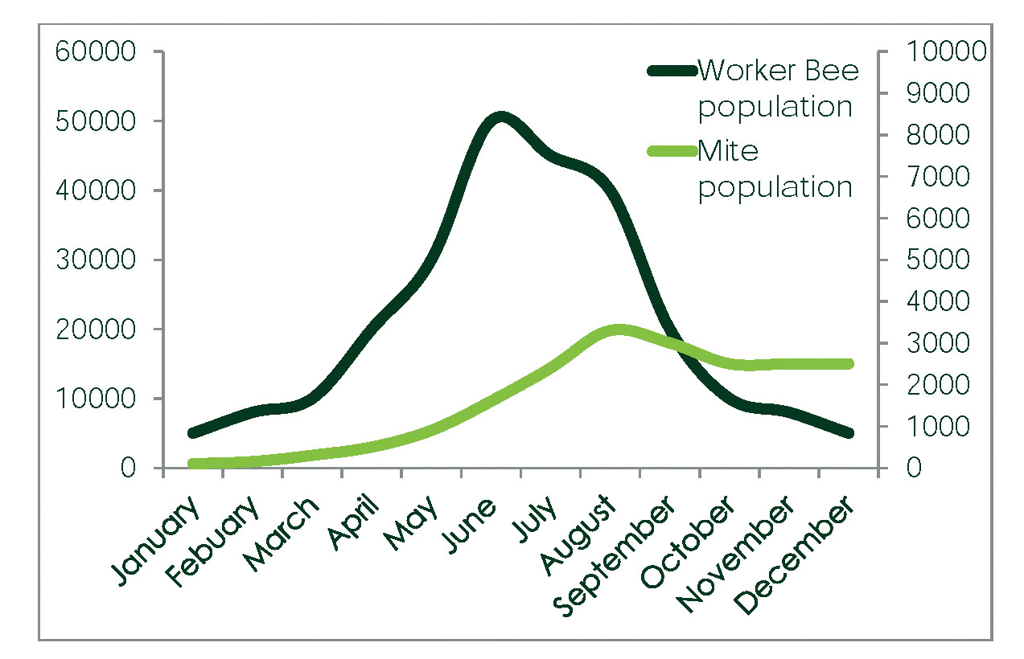

Slide 37
Implications
Grow apiary inspection programs
Fund pathogen monitoring programs to ensure that new diseases don’t get introduced.
Adjustments to management practices

Slide 38
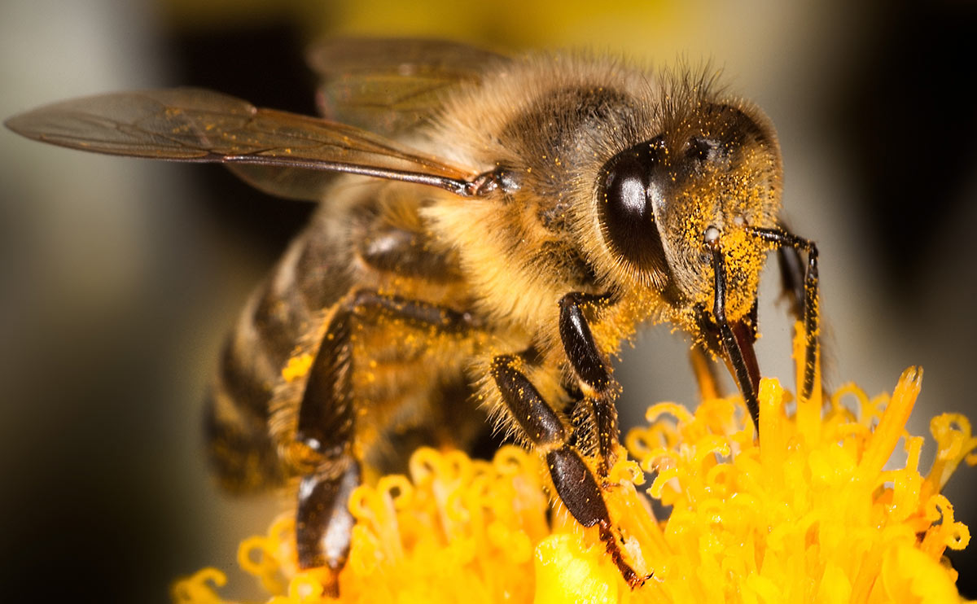
Thank You!

Slide 39
Questions?

